Slide 1

Empower Rural Iowa Broadband Program
Capital Projects Fund (“CPF”)
Pre-Application Conference
June 28, 2023

Slide 2
Introductions
Matt Behrens, Chief Information Officer
Awna Kotchian, Contracts Manager
Joe Drahos, GIS Specialist
Greg Loebe, Project Manager, FG
Kent Van Metre, Vice President of Client Services, FG
Patrick Wilke-Brown, Geospatial Coordinator
Jessica Turba, Program Administrator
Notes:
Jessica

Slide 3
Agenda
Administration and Timeline
Review of NOFA Exhibit A and CPF
Review of Map V5
Review of Broadband Core Application
Review of Application Materials
Review of Request for Confidentiality
Technical Assistance Resources
Questions and Answers
Notes:
Jessica

Slide 4
Administration
This conference is being recorded. The recording and the slide deck will be made available on our website within the next week.
Please mute your audio and type your questions into the chat window. Questions will be addressed throughout the meeting.
Any answers provided today are non-binding on the office.
For a binding response, questions must be submitted via a Google Form that will be live at the close of this conference. Questions can be submitted through July 7.
Helpdesk email: ociogrants@iowa.gov
Notes:
Jessica

Slide 5
Timeline
EVENT | DATE
1.7.1 NOFA Pre-Publication Notice | 6/15/23
1.7.2 Written Questions and Responses | When
1.7.2.1 Pre-Application Conference: | 6/28/23 at 2:00 CST
1.7.2.2 Written Questions Submissions: | 6/28/23 - 7/07/23
1.7.2.3 Responses Posted By: | 7/14/23
1.7.3 NOFA Issuance; Application Acceptance Window Opens (no Applications will be accepted prior to this date and time) | 7/14/23
1.7.4 Application Acceptance Window Closes/ Applications Due (no Applications will be accepted after this date and time) | 8/25/23, 5:00 PM CST
1.7.5 Application Review Ends: | 9/22/23
1.7.6 Final Agency Decision(s)/Notice of Intent to Award (Anticipated) | 9/22/23
1.7.7 Grant Agreement Negotiation and Execution | 10/27/23
Notes:
Jessica

Slide 6
NOFA #008 Highlights
$148,960,000 million in funding available
Federally-funded. American Rescue Plan Act Capital Projects Fund (CPF)
Adds requirements for reporting and monitoring
  Projects awarded grant funds of $5 million or more will have additional obligations.
Prioritizes 96 Broadband Intervention Zones (ITQ)
Up to 80% matching funds available to Eligible Service Locations
100/100 buildout, however 100/20 buildout may be proposed if scalable to 100/100.
Allowable costs can include middle-mile costs necessary to facilitate last-mile service
Projects must be completed by September 30, 2026
Notes:
Jessica

Slide 7
Transition to Exhibit A
https://ocio.iowa.gov/sites/default/files/exhibit_a_-_notice_of_funding_availability_-_nofa_008.pdf
Notes:
Matt

Slide 8
Map V5
Prior Incentives
Overview of Broadband Map V5
Eligible Service Locations and Broadband Intervention Zones
Selection Tool Map and Data Export Instructions
Notes:
Joe

Slide 9
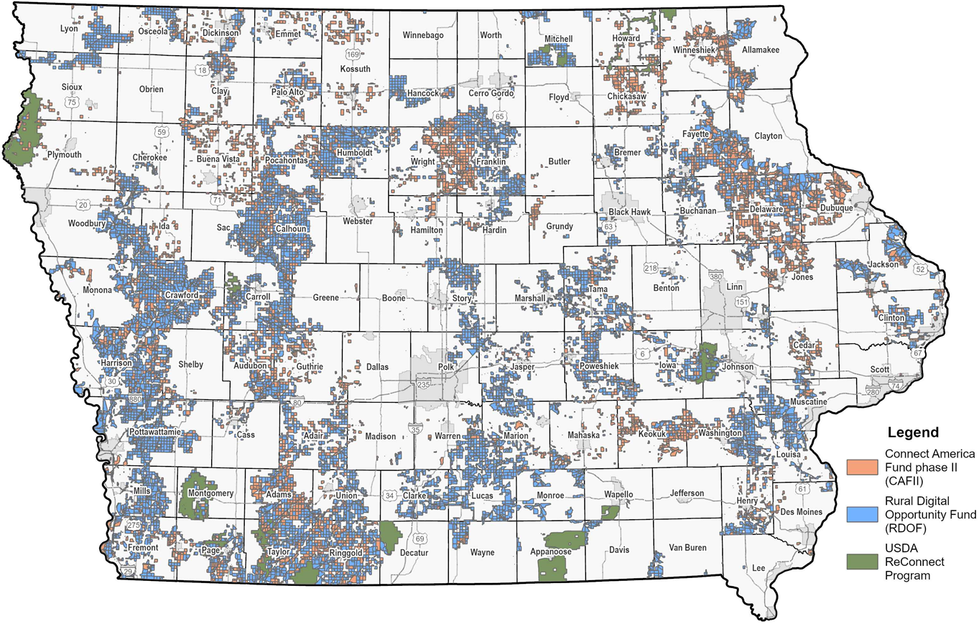
Previously Funded Areas
Under this NOFA, areas that have received prior incentives issued by the Office are not eligible under this program, except for those incentives where the Office funded 25/3 wireless buildout. The Previous Incentives Blocks layer will show applicants areas that will be excised from Applications before making final awards. Do not include these areas in your Applications.
NOTE: Other federal programs not issued by the Office may also be excised from Projects, especially where the Office has data from FCC, USDA, or other programs that 25/3 wireline or faster service was funded by federal agencies.
Notes:
Joe

Slide 10
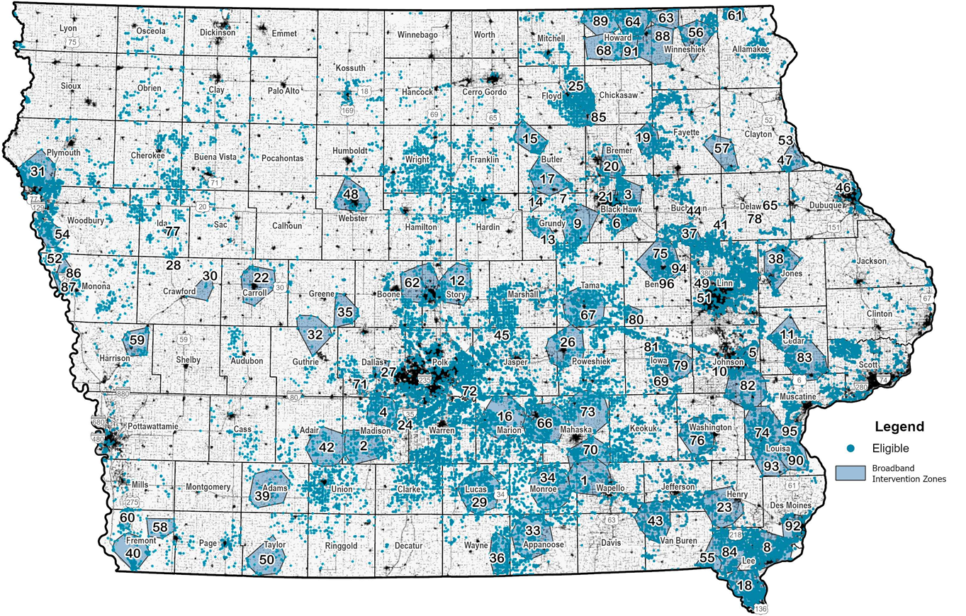
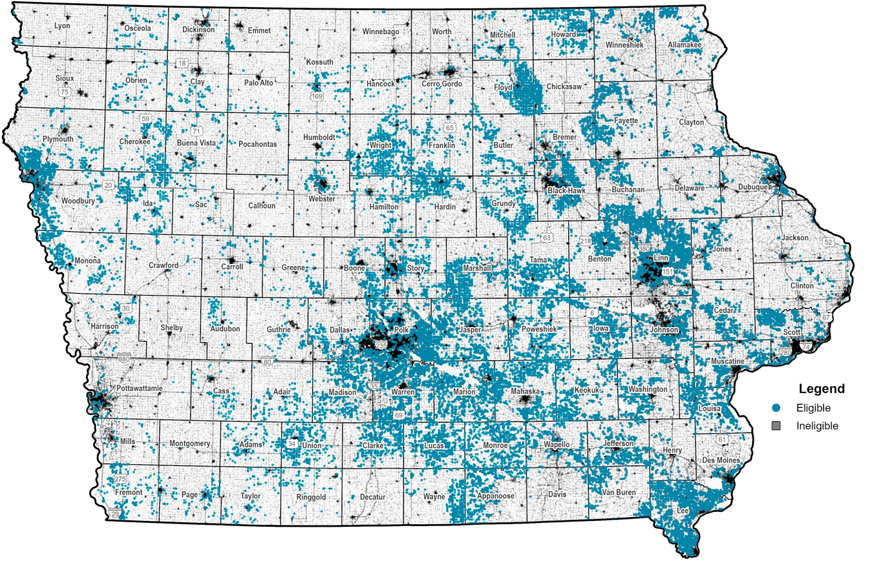
Broadband Map V5
NOFA 8 Eligibility
Notes:
Joe

Slide 11
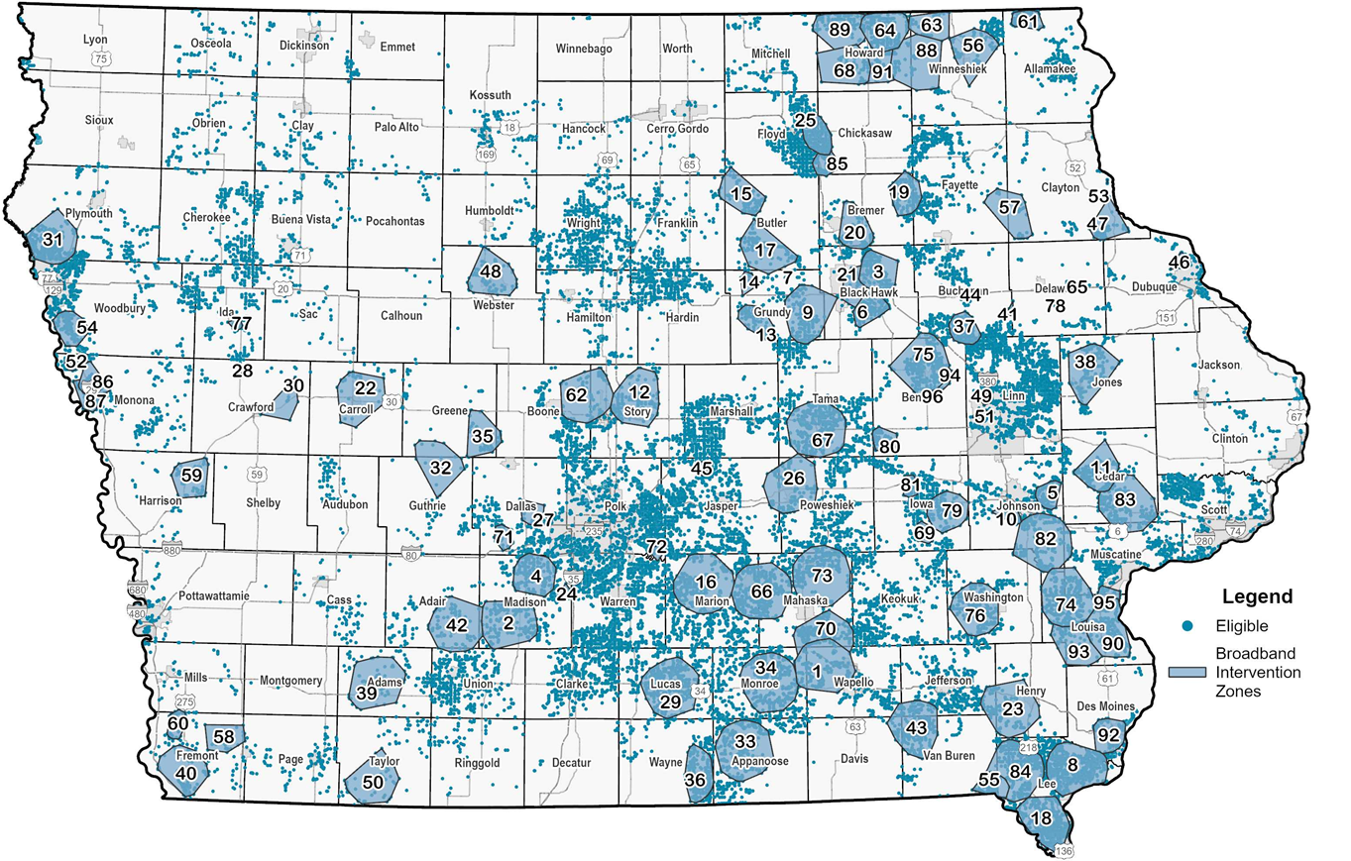
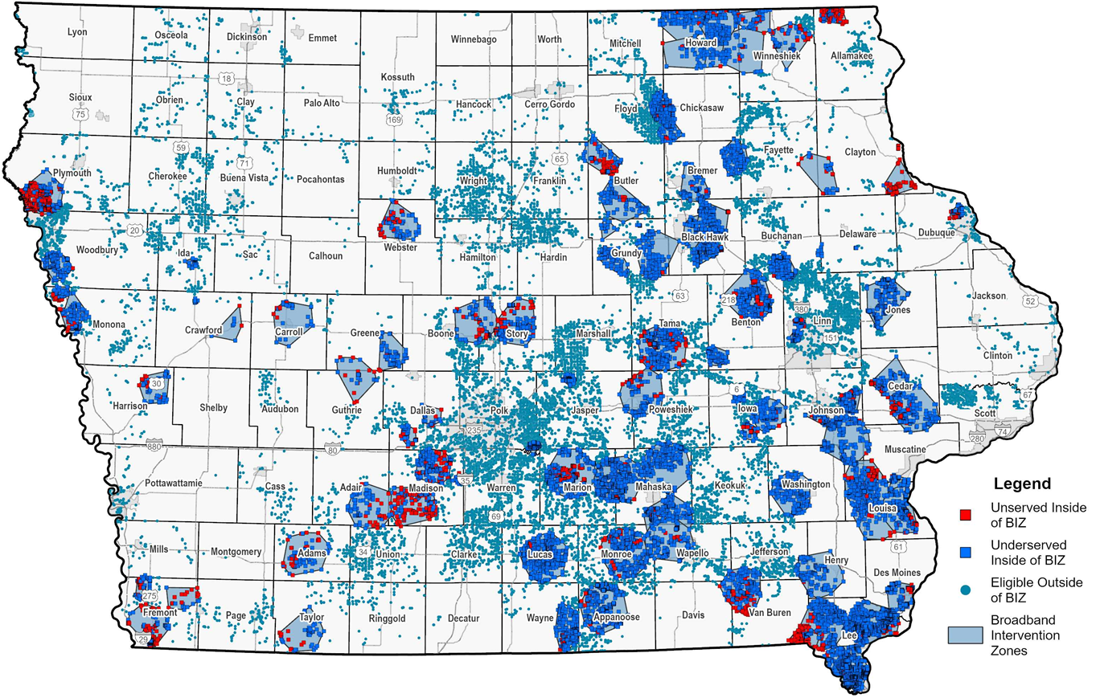
Broadband Intervention Zones
and Eligible Service Locations
Notes:
Joe

Slide 12
Map Data Export Instructions Overview
Description of how to extract the necessary data from the map.
See Exhibit K for further information.
Selection Tool map - https://iowa.maps.arcgis.com/apps/webappviewer/index.html?id=e9d5ba9cb3994b9c9fef59cee6bd4c4d
Exhibit K - https://ocio.iowa.gov/sites/default/files/exhibit_k_-_project_selection_and_data_export_import_instructions_nofa008.pdf
NOFA 8 info - https://ocio.iowa.gov/empower-rural-iowa-broadband-grant-program-notice-funding-availability-008
Notes:
Patrick/Joe

Slide 13
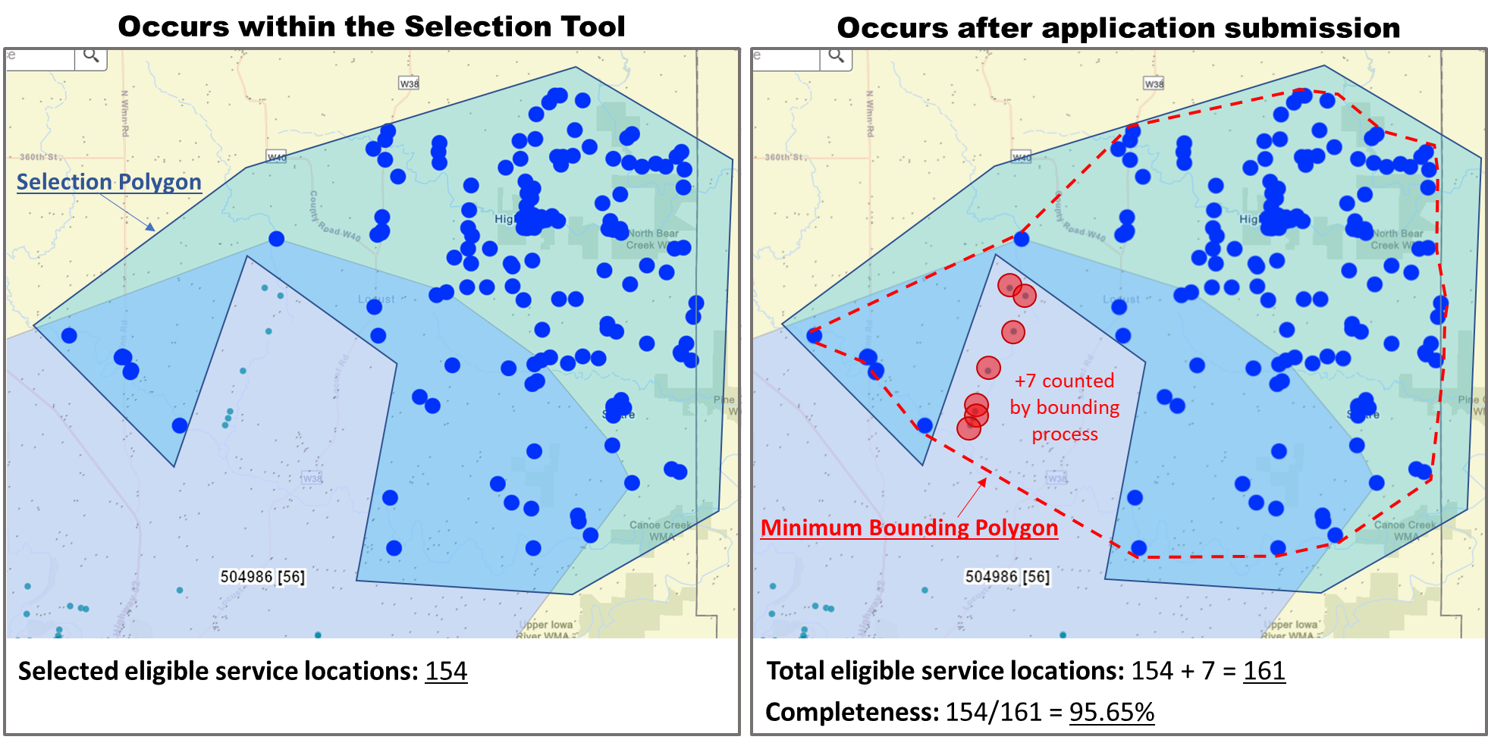
Completeness
Notes:
Patrick/Joe

Slide 14
Broadband Core Application
Menu Tab
ESL Input Tab
Exhibits B-D
Core Application Checklist
Redaction Button
Questions
Notes:
I will be providing an overview of the various tabs and function of the Core Application Workbook.
For the purpose of today’s presentation, this will be fairly high level, but we will be posting a Core Application tutorial that will guide you through the details of each section.
Note that this is an Excel Workbook that contains Macros. You will want to ensure your machine and Excel application settings are such to allow Macros to function. We will cover how to do this in the Core Application Tutorial that I previously mentioned.

Slide 15
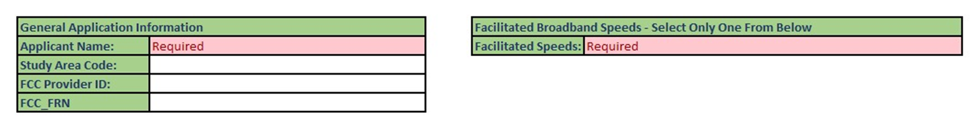
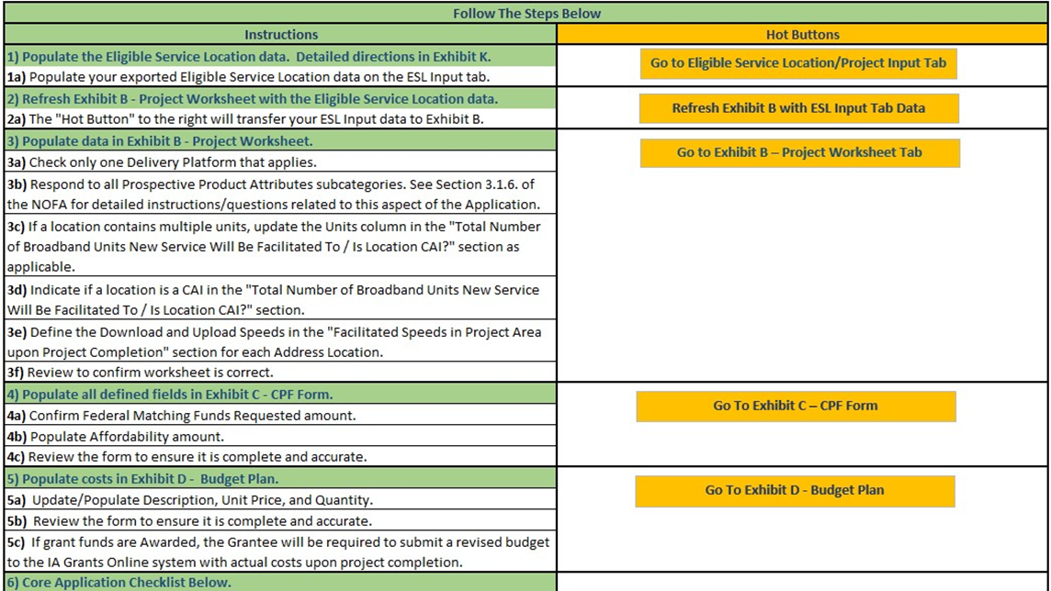

Menu Tab – General Information
Notes:
●The Menu tab will collect some organization information at the top of the screen with Study Area Code, Provider ID, and FRN all identifiers assigned by the FCC. A Provider ID Table will be available for reference once the Application Window opens.
●Step-by-step instructions to complete the Core Application are listed on the page, with hot buttons to jump to various sections.
●The hot button for step 2 is to Refresh Exhibit B with ESL Input Tab data and we’ll get into that on the next slide.
●At the bottom of the Menu tab is a checklist that we will cover in a moment.

Slide 16
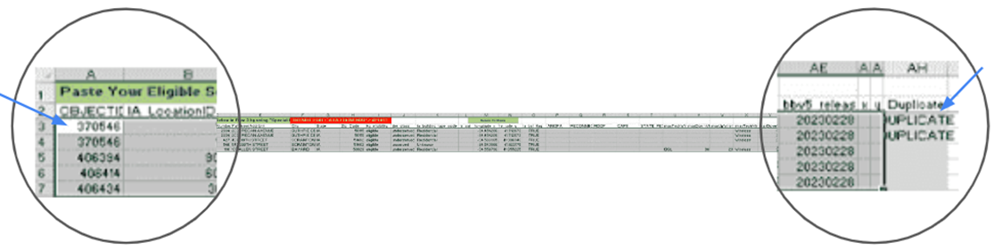
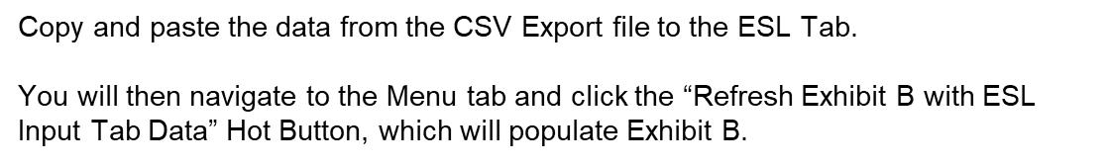
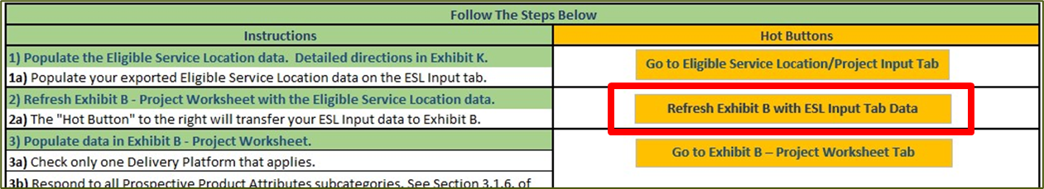
ESL Tab
Notes:
●ESL stands for Eligible Service Locations – meaning the blue dots on the BB map or locations that are unserved and underserved.
●You will follow the steps from the Map Selection and Export/Import Instruction to select your project area and export the data to a CSV file.
●You will then copy/paste the data (minus the header row) into the fields on the ESL tab.
●Once you have pasted in the data, return to the menu tab and click the “Refresh Exhibit B with ESL Input Tab Data” button.
●This will populate Exhibit B with location data, which will later be used to auto-calculate some required figures for you.

Slide 17
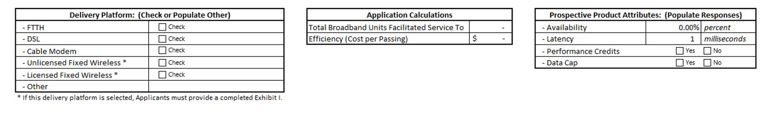
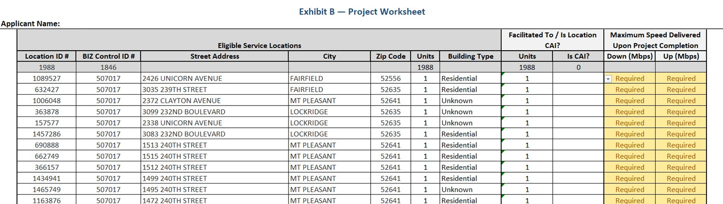

Exhibit B
Notes:
●Here you see an example of Exhibit B with sample data as populated from the ESL Tab.
●At the top of the screen, you will need to enter the delivery platform (note that you can only select 1).
●The Application Calculation section will auto-populate as you complete the required steps on the remaining tabs
●Prospective Product Attributes: These are entered by the applicant per your network capabilities
●At the right of the project worksheet, you will need to populate the Facilitate Units and CAI’s as applicable
○Unit count defaults to 1. If you’re aware the location is a multi-unit dwelling, please indicate the number of units. Same with CAI’s, indicate Yes if the locations is a CAI
●you will also need to populate the max down/up speed available upon project completion to each location. Note this is not max advertised speed, but delivered speed, so consider any impact distance or other factors may have when populating this section of the form.

Slide 18
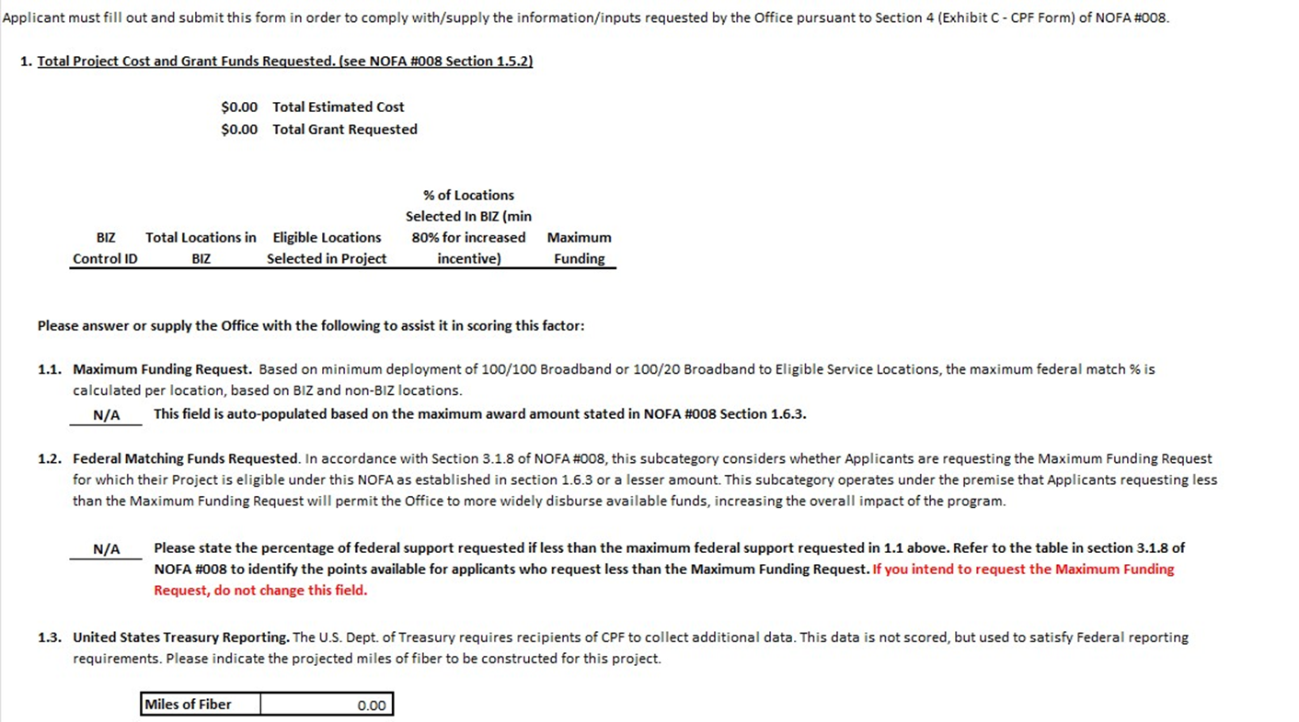
Exhibit C
Notes:
●OCIO has improved the functionality of the Core Application, allowing for key figures to be auto-calculated and populated for you.
●On-screen is Exhibit C as it looks prior to completing the other tabs of the workbook.
●Total Estimated Cost and Total Grant Requested will populate from Exhibit D
●The Maximum Funding Request will be auto-calculated based on the locations selected on the map. A table showing locations within and outside a BIZ will also populate.
●All that is needed from you is to enter the Miles of Fiber, if you are installing a fiber network
●Federal Matching Funds Requested can be changed IF you are requesting a lesser funding percentage than the Maximum. If you are requesting the Max, no change is needed.

Slide 19
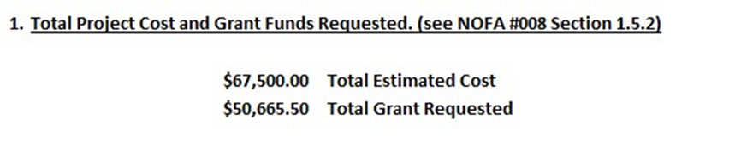
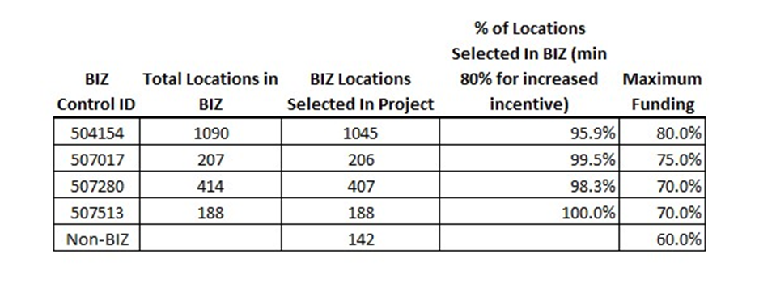
Exhibit C – Sample Data
Notes:
●Here is a sample of Exhibit C with populated data.
●You see sample cost and grant $$, which populate from your budget in Exh D
●Also you see the BIZ table. In this example you can see that multiple BIZ were selected, as well as the % of each BIZ you have selected. This can be helpful if you are just below that 80% coverage mark of a BIZ as you may want to redo your selection to add a few more locations in order to receive the enhanced incentive for those locations.

Slide 20
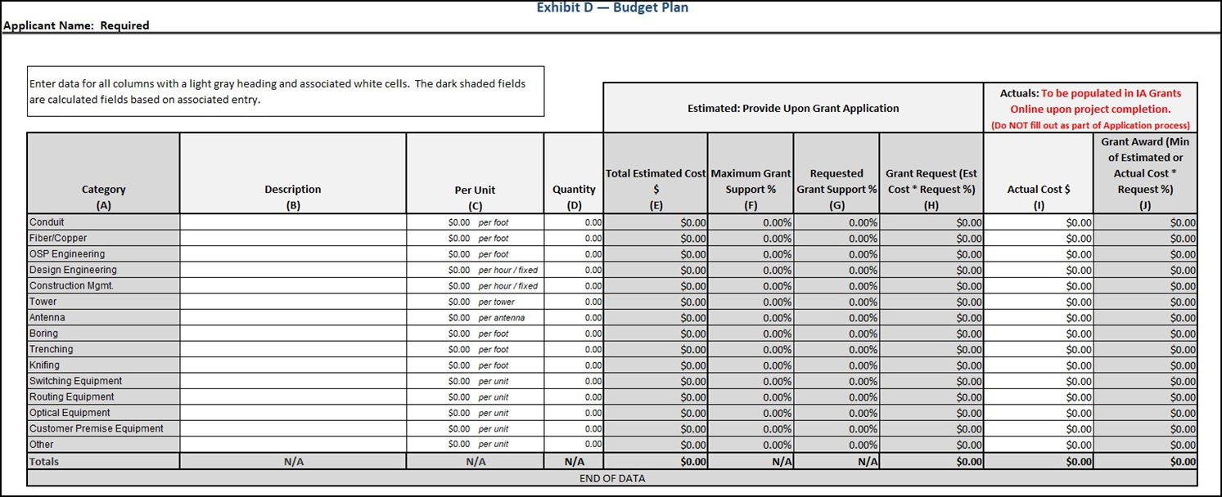
Exhibit D
Notes:
●OCIO has again simplified process by eliminating the need to differentiate between costs within the project area and those that fall outside. Instead, you will enter the total estimated costs for your project on Exhibit D.
●Enter a brief description of the equipment/services to each row in column B as applicable.
●You will then enter the per unit cost for each line item, followed by the quantity.
○This may require some calculation if you purchase materials in differing increments than listed on Exh D.
●The Total Estimated Cost for each line item will then auto-calculate, which will in-turn calculate the remaining fields based on your input to previous tabs.

Slide 21
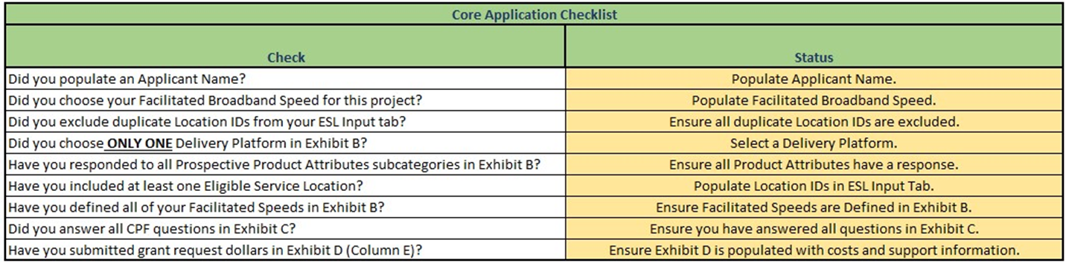
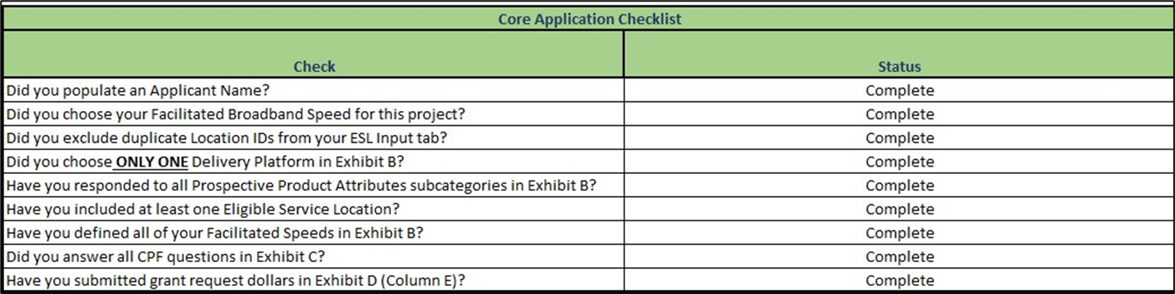
Menu Tab – Core Application Checklist
Notes:
●After completing the information in all tabs, you will come back to the Menu tab to ensure all in the checklist are marked as “Complete”.
●If something is not complete, you will see a yellow message with some text to clue you in on what may be missing.

Slide 22
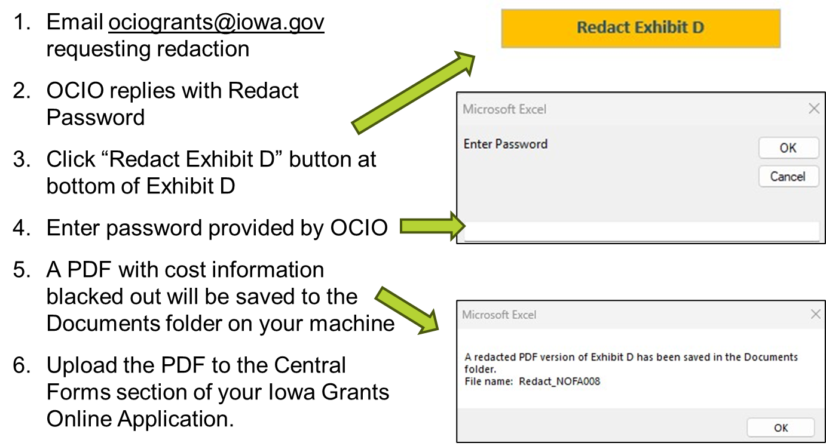
Redaction Process
Notes:
●We will talk more about requesting confidentiality shortly but want to talk through the process to redact the cost-related data from Exhibit D of your Core Application.
●If you’re requesting confidentiality of this section, please note that you will upload an unredacted version of the Core App, as well as the redacted PDF that will result from this process, to the IA Grants system.
●First, you need to email ociogrants@iowa.gov indicating that you’re requesting confidentiality. OCIO will then reply with a password which will be needed in order to generate this PDF.
●With the password in-hand, click the Redact Exhibit D button, found at the bottom of Exhibit D, enter the password when prompted, and a PDF copy with the costing information blacked out will be produced and saved to your documents folder, ready for upload to IA Grants.
●And that’s it!
●Again, we will be providing a tutorial that will go over Core Application completion step-by-step, so be sure to check that out once the Application Window opens on July 14th.

Slide 23
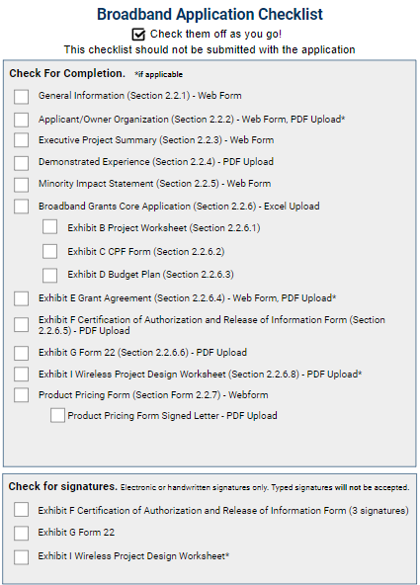
General information
Applicant/Owner Organization
Executive Project Summary
Demonstrated Experience
Minority Impact Statement
Broadband Grants Core App (Exhibits B-D)
Grant Agreement (Exhibit E)
Certification/Authorization/Release (Exhibit F)
Request for Confidentiality - Form 22 (Exhibit G)
Wireless Project Design Worksheet (Exhibit I)
Product Pricing Form and letter
Notes:
Awna:
General Information is a webform in the Iowa Grants system - use legal business name for contracting and claims purposes
Applicant/Owner Organization upload is required ONLY if the business has a parent/subsidiary relationship
The Executive Project Summary is a webform in Iowa Grants. Heads up: Your Completion date may be sooner than the prescribed completion date of Sept 30, 2026, but no later. This will be indicated in the grant agreement.
Dem Exp is a pdf that must be uploaded. NOFA section 2.2.4 for the information to be included.
Minority Impact Stmt is a webform in Iowa Grants system
The Core Application is an Excel spreadsheet upload. If the Core Application is redacted, please upload both. Be sure the budget amounts in the Core Application are reflected in Iowa Grants.
Grant Agreement upload is required ONLY if you’re proposing redlines.
Exhibit F is an upload; signature in 3 different places.
Form 22 (Exh G) must be filled out, signed, and uploaded regardless of whether confidentiality is being requested.
Exhibit I is the Wireless Project Design Worksheet ONLY IF proposing a wireless project. Both the signature page + design is uploaded as PDF
The Product Pricing Form is a webform that asks you to indicate intended pricing for a variety of speed packages. In conjunction with the Product Pricing Form, you must upload a letter signed from a community representative attesting to the affordability of the covered speed package.

Slide 24
Exhibit G: Form 22 Request for Confidentiality
Identify items for redaction
Cannot redact the following:
  Any data or information supplied through the Project Worksheet (Exhibit B of the Core Application).
  Any data or information supplied through the CPF Form (Exhibit C of the Core Application).
  Any non-cost related data or information supplied through the Budget Plan, such as budget line-item descriptions (Exhibit D of the Core Application).
  The estimated or actual Total Project Cost, including but not limited to, as stated in the Budget Plan.
  Any data or information supplied in response to Section 2.2.2 (Applicant/Owner Organization).
Sign the second page of this form; must fill out the table.
Notes:
Awna
Exhibit G must be signed even if you’re not requesting confidentiality of your application.
There are only certain pieces of your application that you are permitted to request confidentiality for and that it line item costs in Exh D. This you’ll indicate within the Form 22 itself. This is a list of items that you are not permitted to request confidentiality for:
If you’d like to request confidentiality, please contact our helpdesk for assistance.

Slide 25




Technical Assistance
I need help registering for an account.
I need help filling out the Core Application.
Iowa Grants Application Instructions
Broadband Grants Core Application Menu
I need help with the map of my project area.
Project Selection and Data Export/Import Instructions
I have questions not addressed in the NOFA.
Written Responses to Questions Addendum
Still have questions? Contact us at ociogrants@iowa.gov or call 515-218-1413.
Notes:
Awna:
If you need help registering for an Iowa Grants account, Exhibit J Iowa Grants Registration and Application will be useful.
If you need help with the Core Application, refer to the Menu tab within the Core Application that will help to remind you which sections need your attention.
For help with choosing your project area on the map, Exhibit K Project Selection and Data Export/Import instruction will be helpful
If you have questions about the NOFA itself, you can submit your question via the link on our website that will be live following this conference, and a response will be posted and incorporated into the NOFA as of July 14.
Reminders:
All Application Documentation can be found on our website at ocio.iowa.gov under Broadband Grants NOFA #008. OCIO will also be publishing application tutorials available on our website. Keep in mind that the application deadline cannot be extended. You must have your application submitted by 8/25 at 5:00. If you require technical assistance, please contact the helpdesk at least one business day prior to the deadline.

Slide 26
Questions

