Slide 1
Office of the chief information officer
NOFA #007
New Guidance Webinar
September 15, 2023
Notes:
Title page to include presentation title/topic, speaker, date etc.

Slide 2
Agenda
NOFA #007 Grant Recap
Grant Agreement Terms
CSLFRF Requirements
Current Grant Program Requirements
IowaGrants Correspondence Training
Questions & Answers
New Guidance Grant Amendment Overview
Quarterly Status Reporting Changes
Notes:
Standard content slide with two column text option

Slide 3
NOFA #007 Grant Recap
NOFA #007 funds are allocated from the American Rescue Plan Act (ARPA) Coronavirus State and Local Fiscal Recovery Funds (CSLFRF) to support investment in broadband projects “designed to provide an adequate minimum level of service and [that] are unlikely to be made using private sources of funds”
State of Iowa – Recipient of CSLFRF
Grantee – Subrecipient of CSLFRF

Slide 4
Grant Agreement Terms
By executing a grant agreement and accepting a CSLFRF-funded award made available under ARPA and NOFA #007, grantee acknowledges that it is deemed a “Subrecipient” as defined by Applicable Law
Applicable Law: any and all applicable federal, state, foreign, and local laws, rules, regulations, codes, ordinances, policies, orders or any other legal requirements or limitations, and specifically including CSLFRF Requirements in place at execution of the grant agreement, as well as any and all future amendments, changes, or additions to such laws as of the effective date of such change

Slide 5
CSLFRF Requirements
Treasury Final Rule
Treasury CSLFRF Reporting Guidance
Treasury CSLFRF FAQs
Applicable provisions of OMB guidance for federal awards [2 CFR Part 200]
SLFRF Supplementary Broadband Guidance
All future amendments, changes, or additions

Slide 6
Current Grant Program Requirements
Overall organization support:
Procurement Policy
  The non-Federal entity must have and use documented procurement procedures, consistent with State, local, and tribal laws and regulations and the standards of this section, for the acquisition of property or services required under a Federal award or subaward. The non-Federal entity's documented procurement procedures must conform to the procurement standards identified in §§ 200.317 through 200.327.
  Please ensure your policy complies with 2 CFR Part 200.
For each individual procurement:
Procurement Source
  Bid, Sole Source, Change Order, etc.
Proof of Order (Contract / Purchase Order)
  Must be in Period of Obligation (March 3, 2021 – September 30, 2024)
Proof of Purchase (Receipt / Invoice)
  Must be in Period of Performance (March 3, 2021 – September 30, 2026)
Proof of Payment
  Must be in Period of Performance (March 3, 2021 – September 30, 2026)

Slide 7






Amendment Changes to the Grant Agreement
Period of
Performance
Procurement
Changes
Affordable Connectivity
Program
Ownership of
Infrastructure
Annual Review of
Financial Statements
Items purchased before March 3, 2021, are allowable expenses as long as they would have been allowable under the grant agreement
No procurement documentation will be required, which includes contracts and purchase orders
Grantee must participate in the Affordable Connectivity Program and offer customers in their completed project area assistance with enrollment
Ownership of infrastructure must be monitored in accordance with the new federal rules
Review of financial statements must be reviewed yearly instead of at closeout
Notes:
Standard content slide with two column text option

Slide 8




Administrative Processes That Do Not Change
Cost Share
Cost Review
Period of Performance
Progress Monitoring
Payment Review
The cost share will remain the same
Cost review and reimbursement testing, including providing invoices and proof of payments
Certification at the end of the performance period that the broadband project and activities were completed. The performance period is either the date you previously indicated for project completion, but no later than September 30, 2026
Project progress monitoring throughout the period of performance
Grantee payments may be delayed or rejected if a grantee has not made substantial progress that correlates with the funding received to date
Notes:
Standard content slide with two column text option

Slide 9
Quarterly Status Reporting Changes
  As the United States Treasury continues to change the necessary reporting for American Rescue Plan Act funds, OCIO will need continued input from NOFA #007 awardees
  NOFA #007 projects are required to submit addresses that are or will be associated with their broadband project. Addresses and locations should correspond to information that may exist on planning or as-built network engineering documents.
  Review, edit and confirm the location data sent to grantees on August 30, 2023 and upload with your quarterly report
9

Slide 10



SLFRF Supplementary Broadband Guidance & New Guidance Amendment
Supplementary Guidance
Released
Changes Adopted
Grant Amendment
OCIO has agreed to adopt the changes and is offering those changed requirements to NOFA #007 grantees
OCIO released amendments to each grant project on Monday, August 7 and are due by September 30, 2023
On May 17, 2023, US Treasury released the SLFRF Supplementary Broadband Guidance that applies to broadband infrastructure projects funded by SLFRF
10

Slide 11
IowaGrants Correspondence
Subrecipients should use the Correspondence Portal within IowaGrants to communicate with the review team
IowaGrants is the system of record; since the UST has until 2032 to audit any of these funds, this will allow us to maintain all records until that time

Slide 12
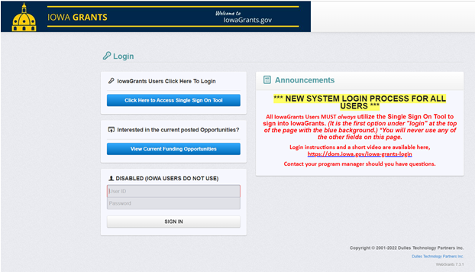
IowaGrants Correspondence Training
1. Select “Click Here to Access Single Sign on Tool” and sign in.

Slide 13
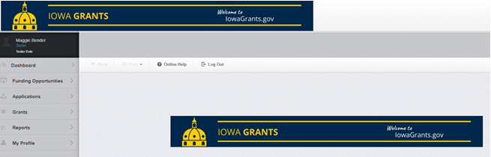
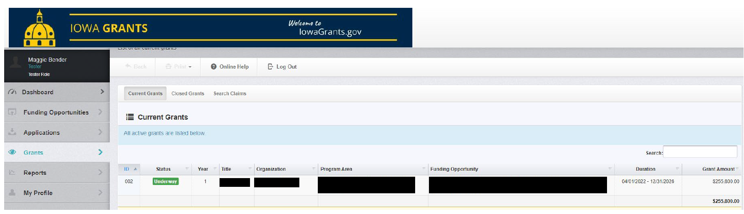
IowaGrants Correspondence Training Continued
2. Select “Grants”
3. Select applicable grant

Slide 14
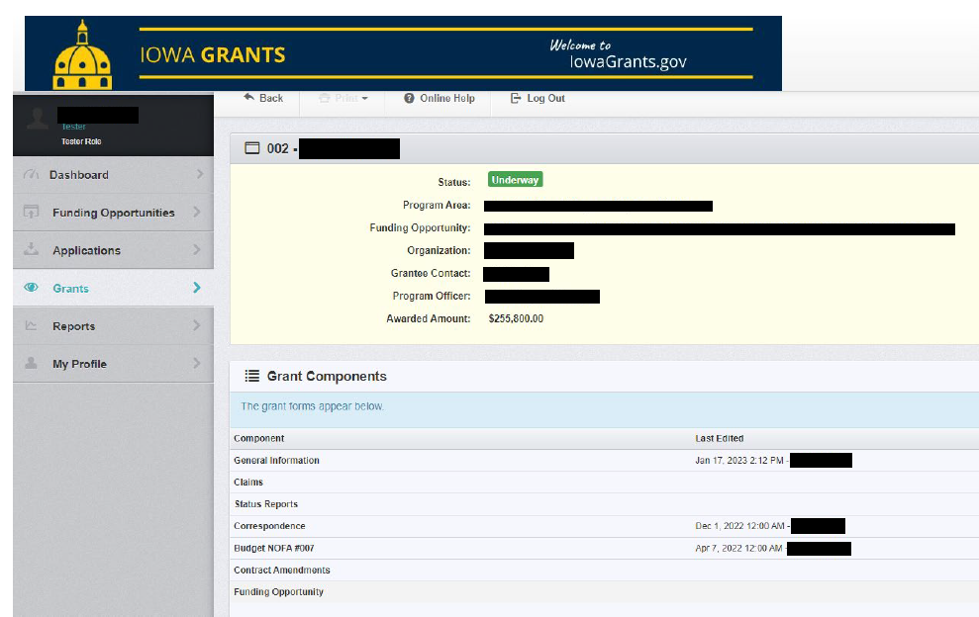
IowaGrants Correspondence Training Continued
4. Select “Correspondence”

Slide 15
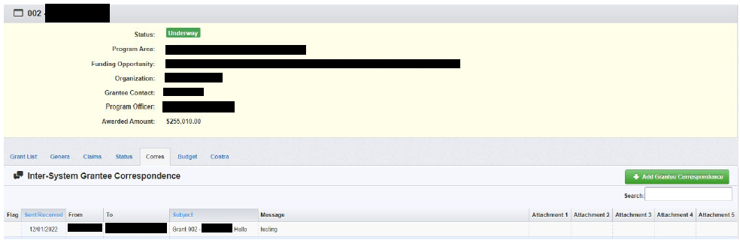
IowaGrants Correspondence Training Continued
5. Select “Add Grantee Correspondence”

Slide 16
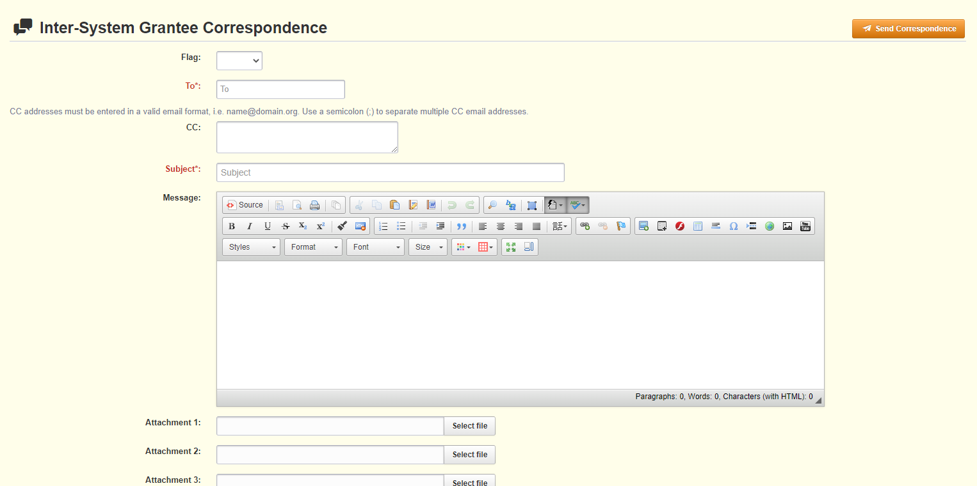
IowaGrants Correspondence Training Continued
6. Add “RSM Program Manager” in the “To” field
7. Add a subject
8. Draft your message
9. Attach files, if needed
10. Send correspondence
6
10
7
8
9

Slide 17
Notes:
[OPTIONAL] If including a question and answer session, this is the preferred splash screen to denote that.

Slide 18
Notes:
[OPTIONAL] Splash screen thanking attendees for their time.

Slide 19
RSM US LLP
+1 800 274 3978
rsmus.com
Notes:
[REQUIRED] This should be displayed at the end of every presentation to cover us from a legal standpoint. Contact information is optional.

